Slide 1
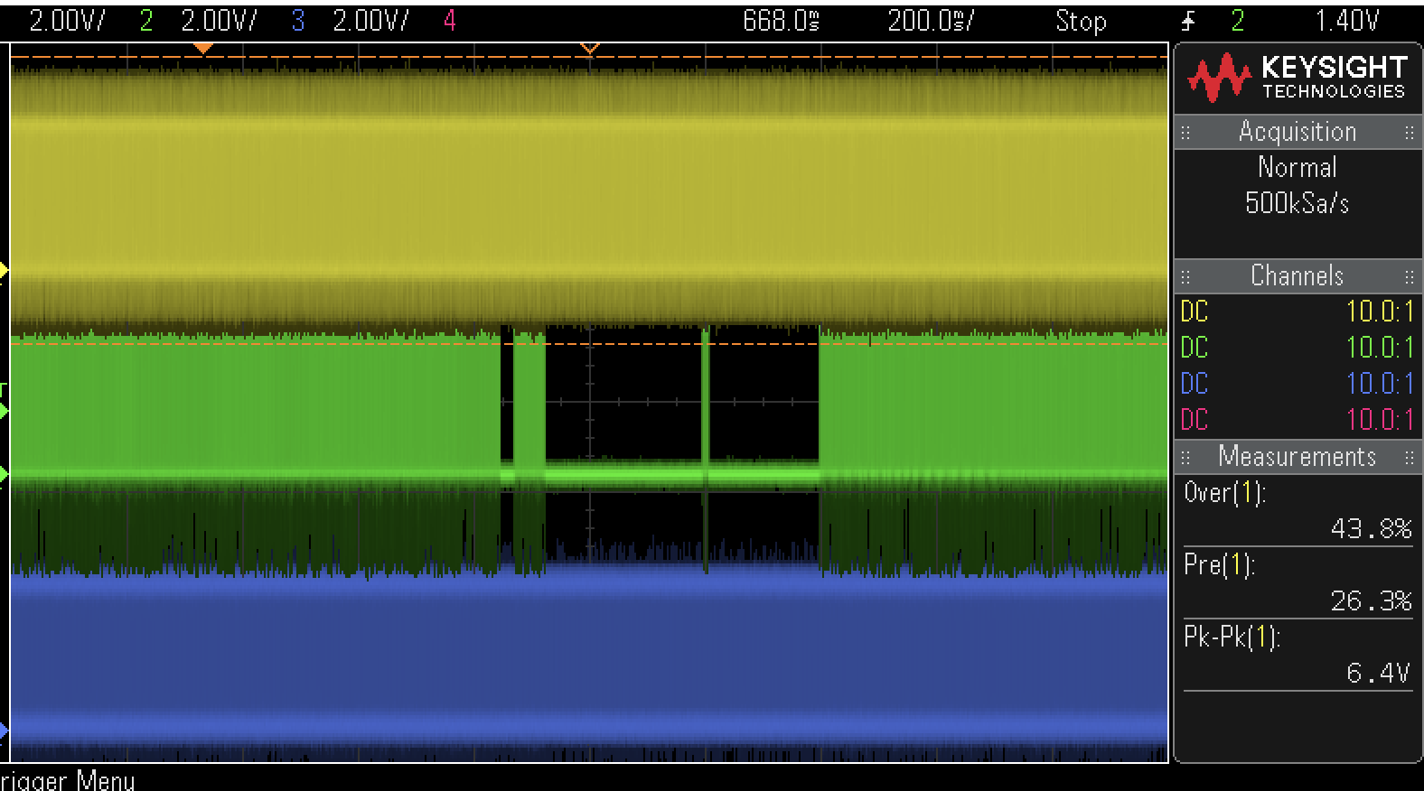
Audio mute when channel moving
Audio mute release after channel moving
Audio Noise
Audio Noise

